Slide 1
Online Classes With Zoom
Step by Step Guide

Slide 2
Step1:
Visit https://zoom.us/
Click on “SIGN UP, IT’S FREE” Button.

Slide 3
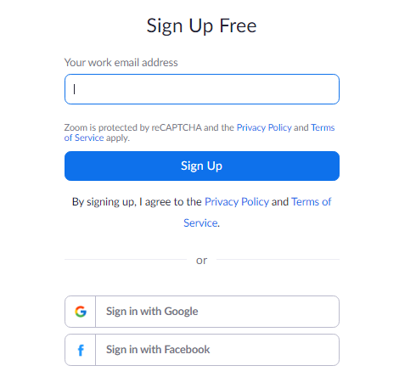
Step 2:
Click on “Sign in with Google” button.

Slide 4
Step 3:
Once you sign in with Google successfully, click on “Schedule a New Meeting” button.

Slide 5
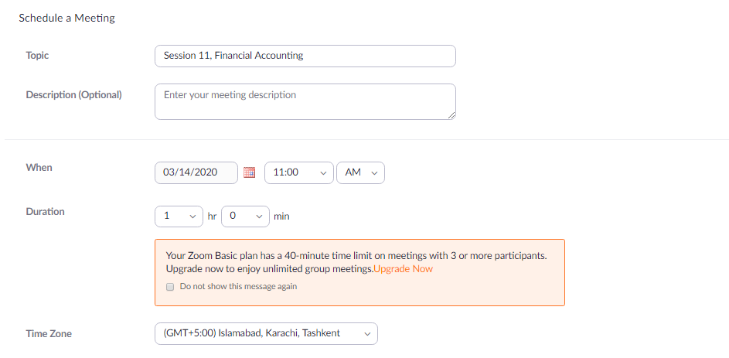
Step 4:
Enter the details of your session accordingly.
Leave other options as default or change them according to your requirements and then click “Save”.

Slide 6
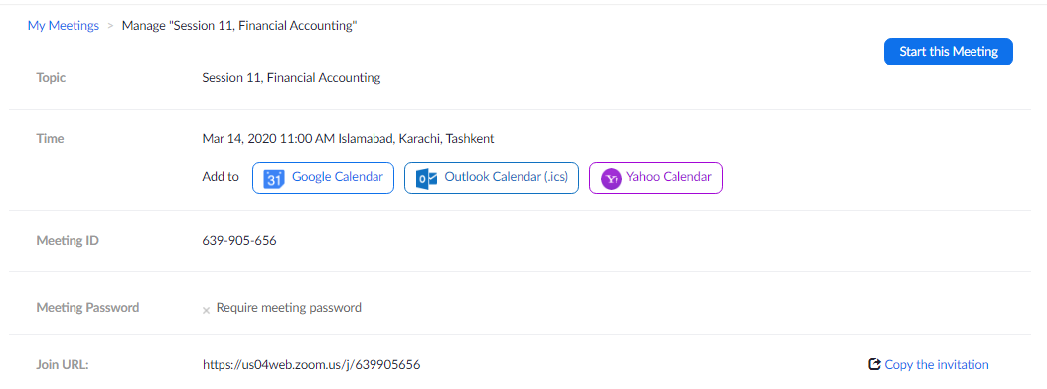
Step 5:
Click on “Copy the invitation” to copy join URL link to forward to students via Email/SMS/LMS etc.
Click on “Start this Meeting” button.

Slide 7
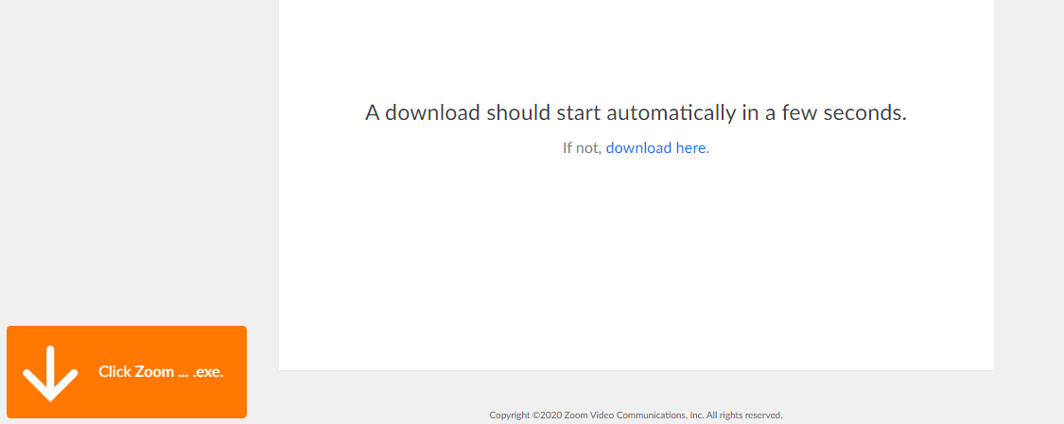
Step 6:
A download will start automatically.
Run the downloaded file once downloading is finished.

Slide 8
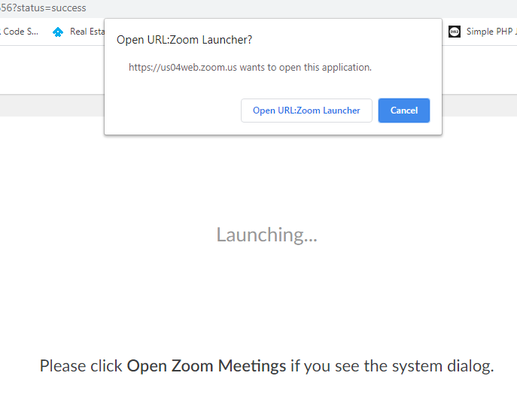
Step 7:
Click Open URL: Zoom Launcher when prompted by the browser.

Slide 9
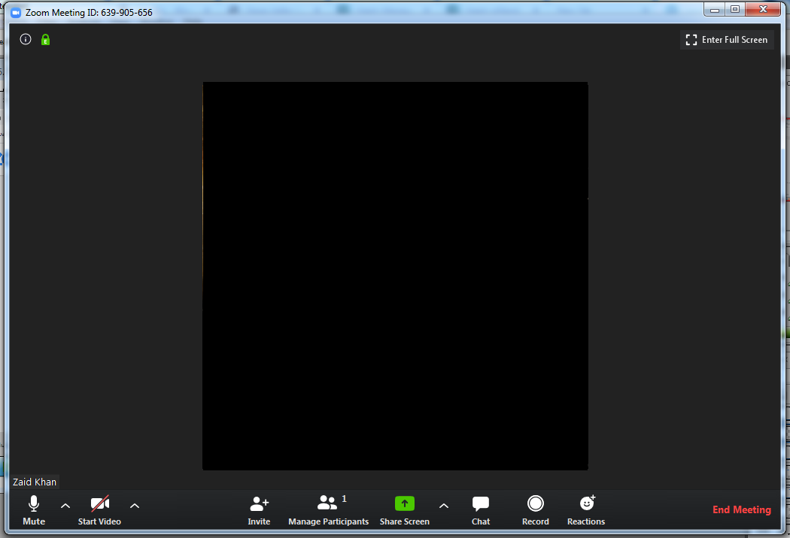
Step 8:
The live session will start now.

Slide 10
For further instructions on how to manage the session please watch the training videos by visiting the following links
https://www.youtube.com/watch?v=ZAYv8sVPTxU
https://www.youtube.com/watch?v=4w_pRMBEALE

Slide 11
For any queries or further training please contact your concerned academic staff.
For any technical issues, contact IT Department or MIS department.

