Slide 1

Achievements
IST Youth Carnival’19: Champions
NERC’19: 1st (2 Competitions)
2nd (2 Competitions)
NED Propellair: Winners
NED SPEC’18-19: Winners
PROCOM’18-19: Winners
IOBM Why-Phy 3.0: Winners
ZABFEST’18: Winners
SUPARCO World Space Week: Runner up
IBA Sukkar’18-19: Winners and Runner up
SPARCOM’18: Winners

Slide 2
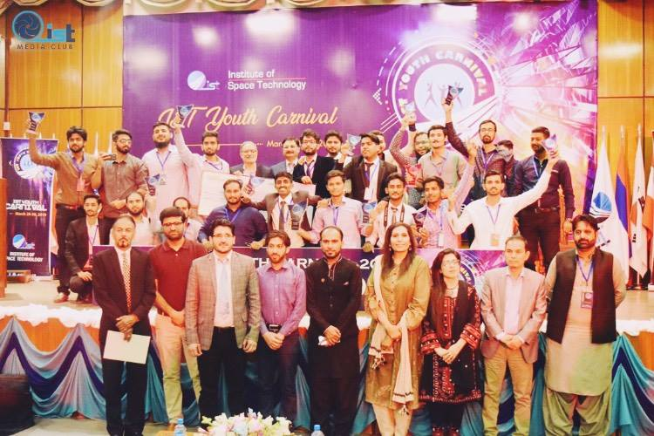
IST Youth Carnival’19: Champions

Slide 3
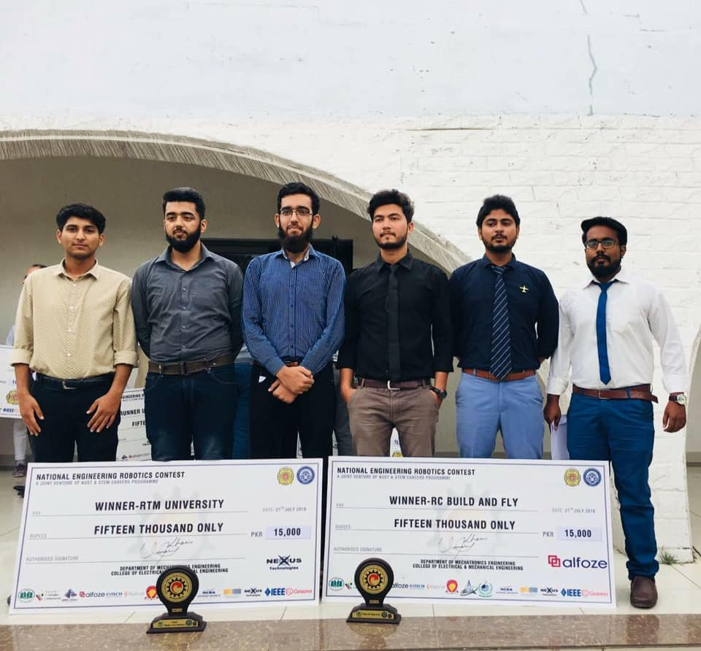
NERC’19: 1st (2 Competitions)

Slide 4
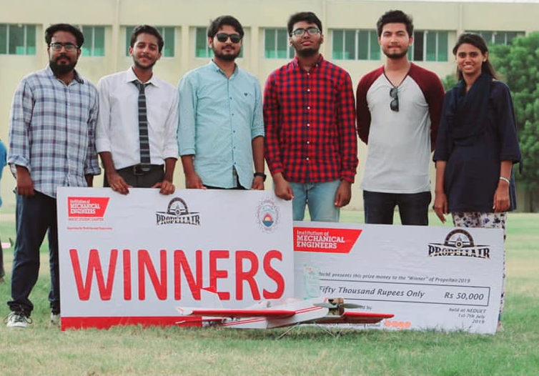
NED Propellair: Winners

Slide 5
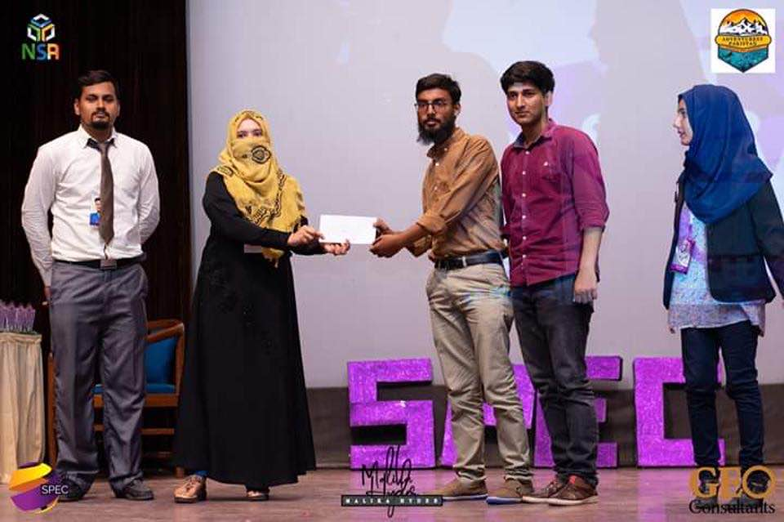
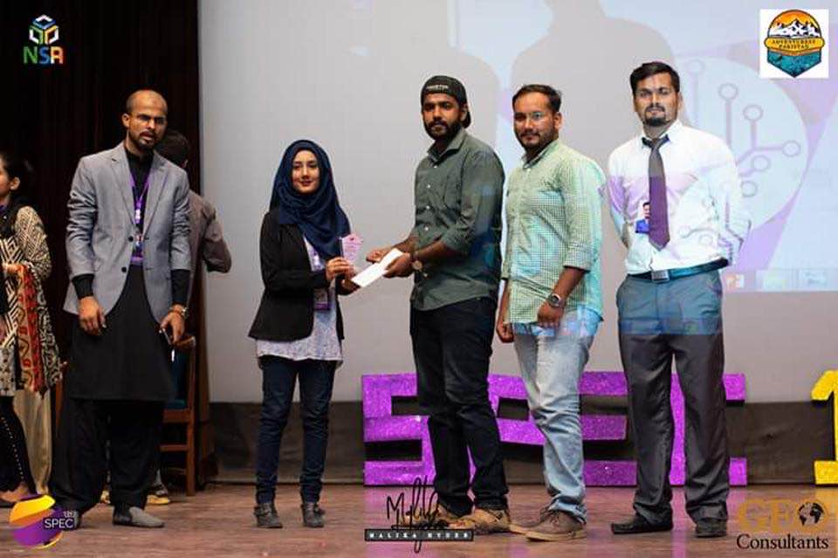
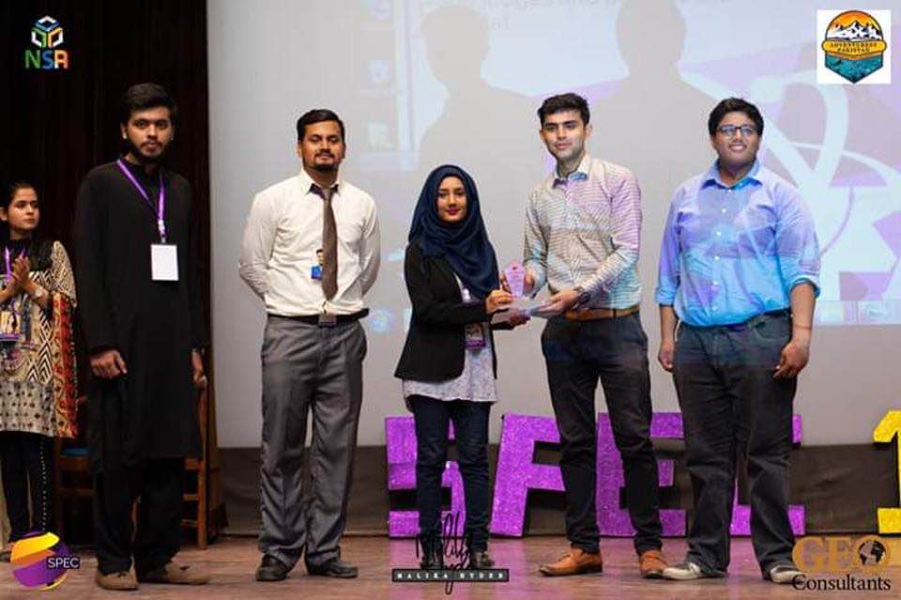
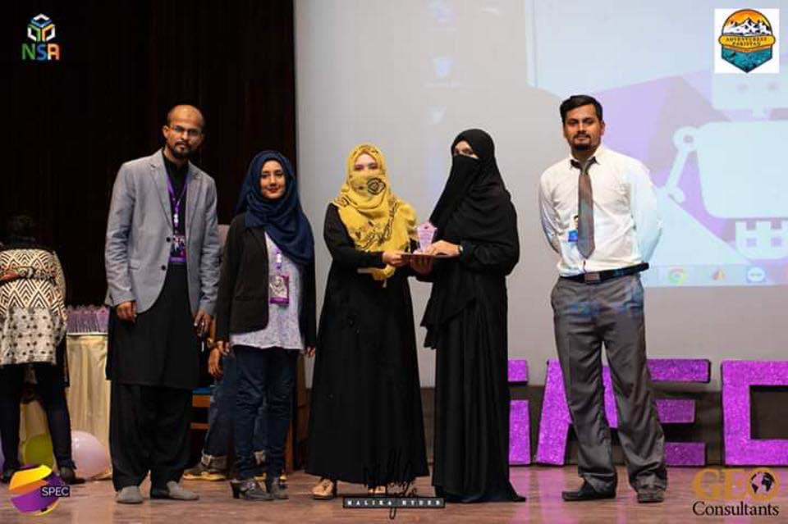
NED SPEC’19: Winners

Slide 6
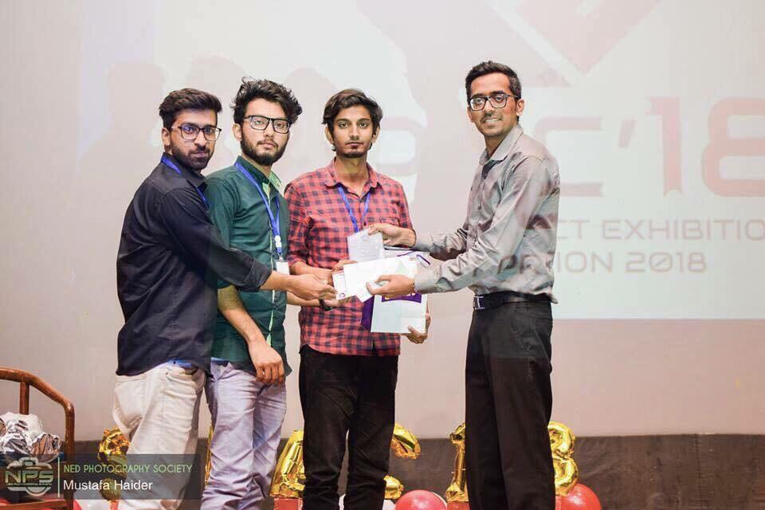
NED SPEC’18: Winners

Slide 7
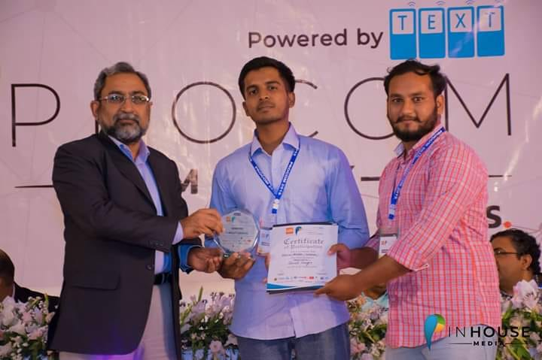
PROCOM’19: Winners

Slide 8
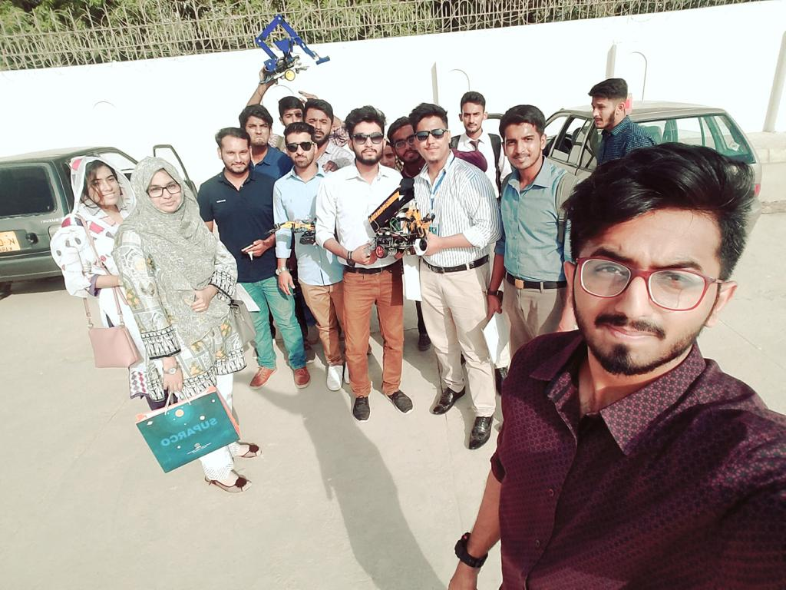
SUPARCO World Space Week: Runner up

Slide 9
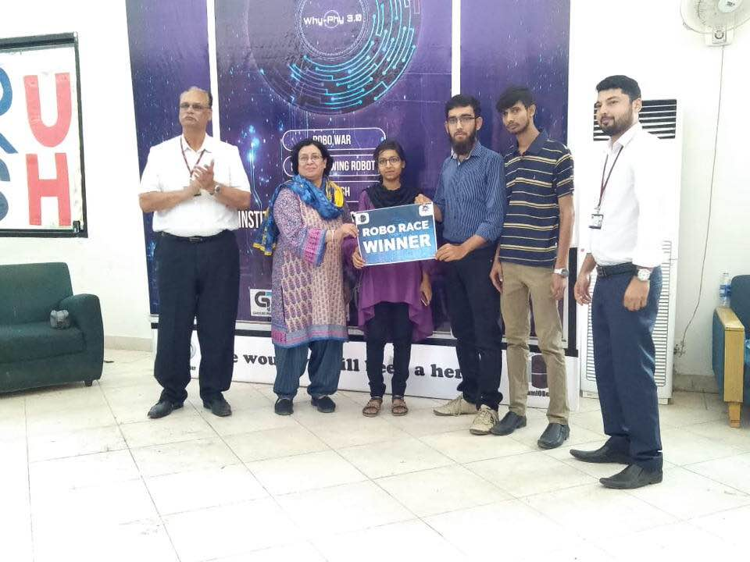
IOBM Why-Phy 3.0: Winners

Slide 10
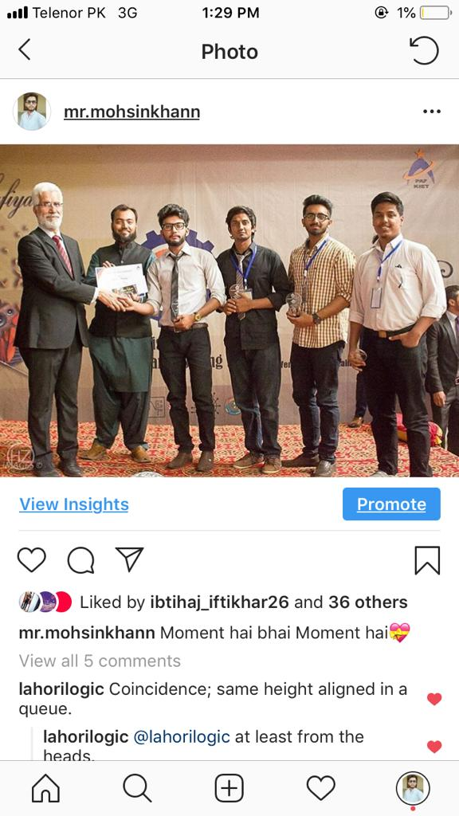
SPARCOM’18: Winners

